Slide 1

SLW Home Improvements
Members
Carson Hatem – Systems Analyst
Austin Bing-Zaremba – Business Analyst
Christian Lancaster – Co-Product Owner
Jackson Ingalls – Database/Programming Coordinator

Slide 2
Introduction
In Sprint 2, we have incorporated feedback from Sprint 1 to improve our scope and documentation
We have also updated our Use Case Diagram & Context Diagram based on our now refined requirements
Additionally, we have defined our non-functional requirements (Operational, Performance, Security, and Usability)
We have also begun the early stages of development, and have updated our PSPI with screenshots from our system
Finally, we have updated our Product Backlog, Sprint 2 Backlog, and set up our Sprint 2 Burndown Chart

Slide 3
Non-Functional Requirements
Operational | Must be accessible via standard web browsers (Chrome, Firefox, Edge, Safari) Must be available at least 99% of the time excluding scheduled maintenance Must be able to handle at least 100 users without a degradation in performance All customers and administrator interactions with the site need to be logged for auditing purposes
Performance | Page load times need not be excessive, ideally within or below 3 seconds load time The database must also be able to respond to queries within 3 seconds Batch processing should be able to complete within 30 seconds The system needs to be scalable, ideally able to handle a 30% increase in traffic annually

Slide 4
Non-Functional Requirements
Security | User authentication must be encrypted All sensitive data such as customer information should be encrypted as well The system needs preventative measures for SQL injection or other similar attack practices Users should be logged out after 15 minutes of inactivity Role based accesss should restrict access depending on your roles
Usability | The UI should be simple and easy to use for customers and for employees Service requests should be completed within 3-5 clicks Admins should be able to update services and access customer data easily Actions should have clear error messages if unable to process requests

Slide 5
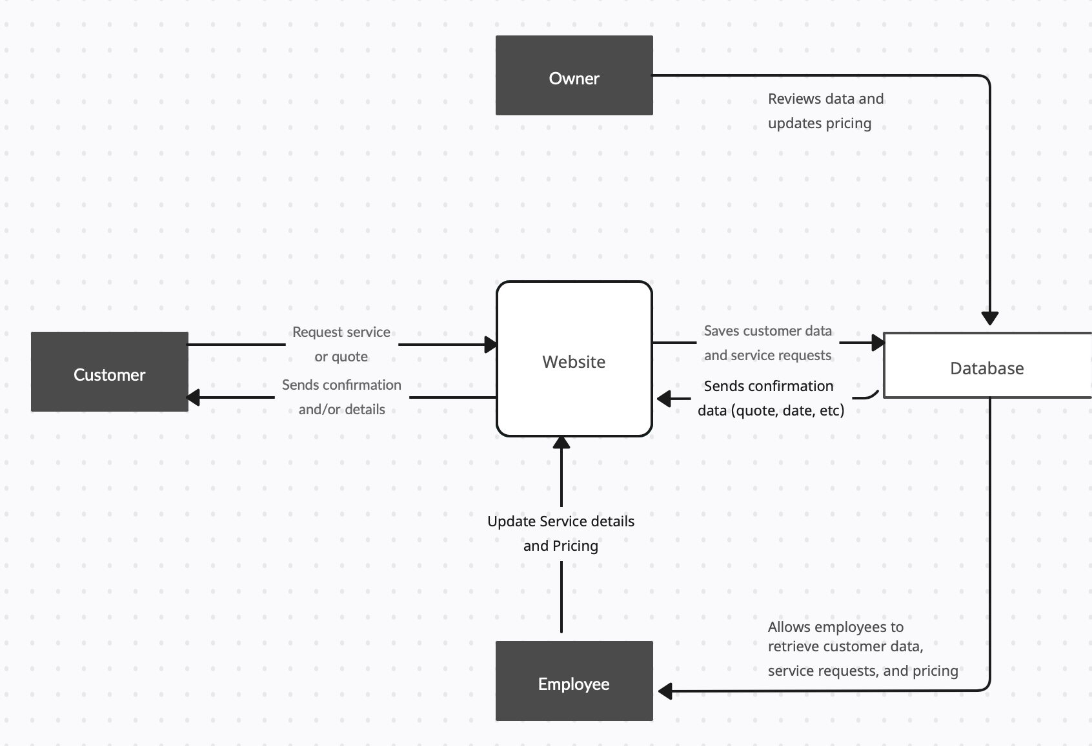
Context Diagram

Slide 6
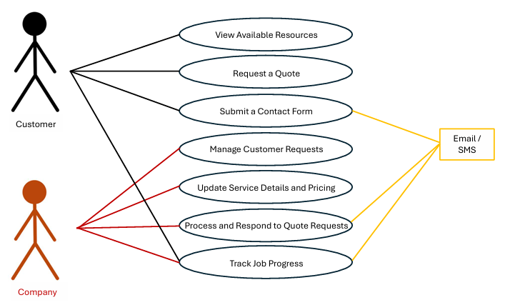
Use Case Diagram

Slide 7
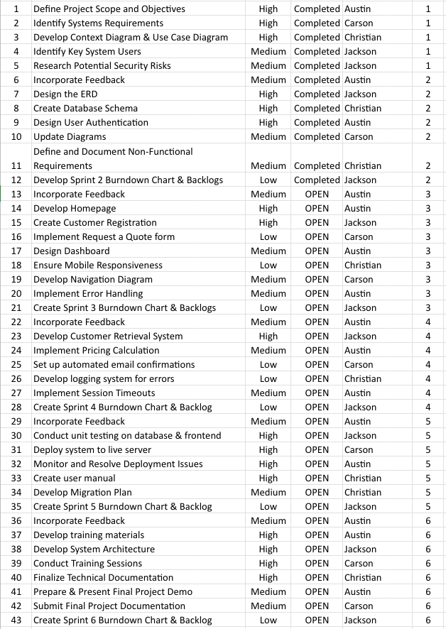
Updated Product Backlog

Slide 8
Sprint 2 Backlog
SPRINT 1 BACKLOG |  |  |  | Assignment
UR# | Item | Priority | Status | Team Member
6 | Incorporate Feedback | Medium | Completed | Austin
7 | Design the ERD | High | Completed | Jackson
8 | Create Database Schema | High | Completed | Christian
9 | Design User Authentication | High | Completed | Austin
10 | Update Diagrams | Medium | Completed | Carson
11 | Define Non-Functional Requirements | Medium | Completed | Christian
12 | Develop Sprint 2 Burndown & Backlog | Low | Completed | Jackson

Slide 9
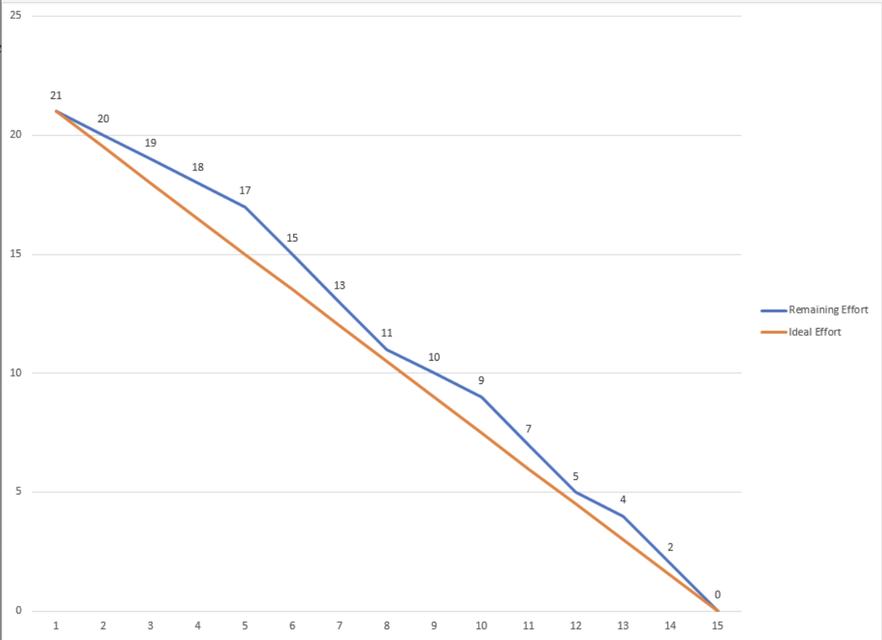
Sprint 2 Burn Down Chart

Slide 10
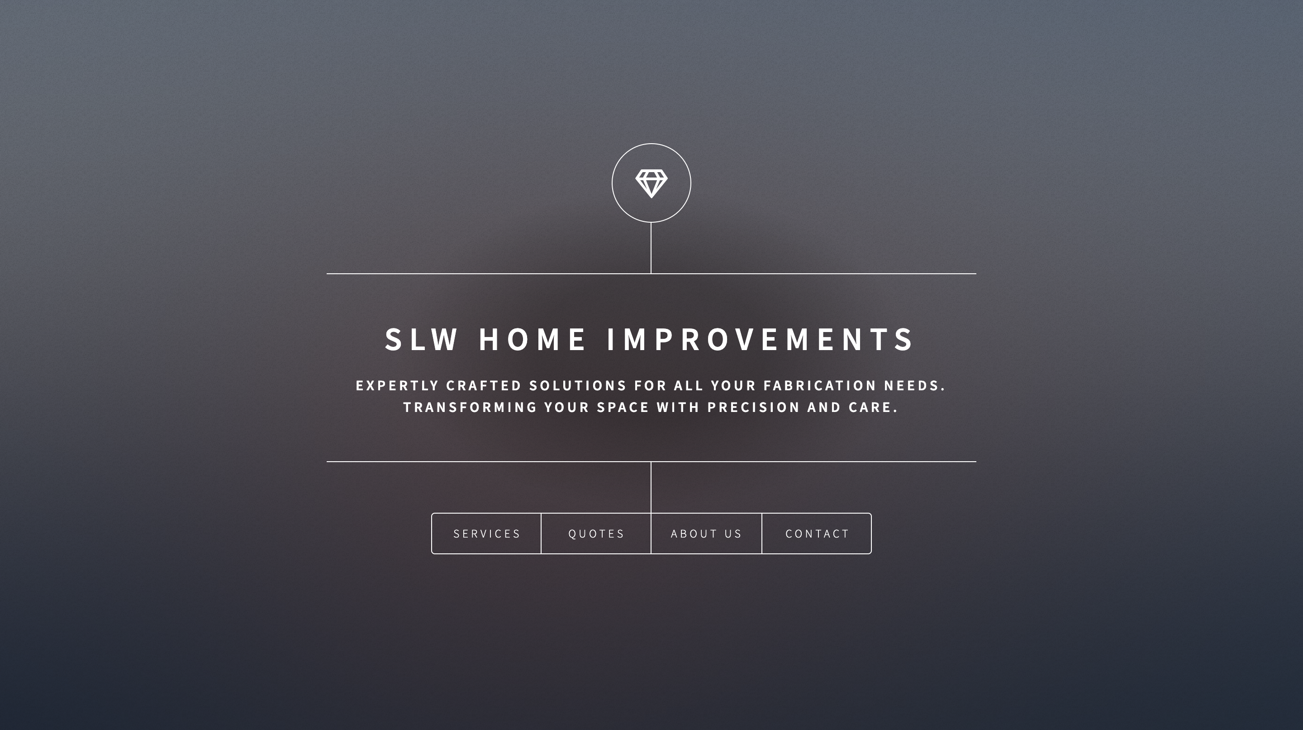
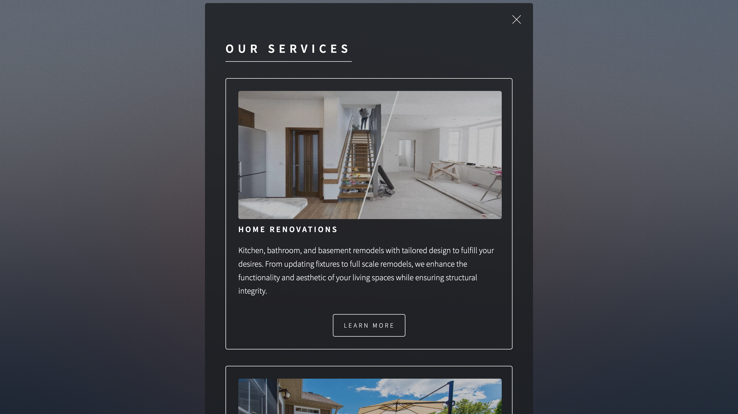
Sprint 2 PSPI
Home Page
Our Services Page

Slide 11
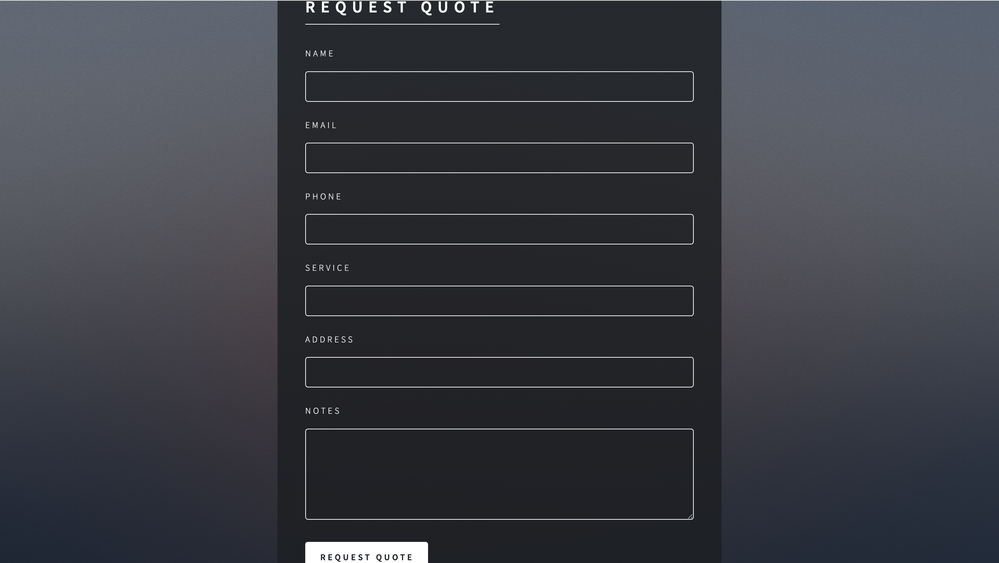
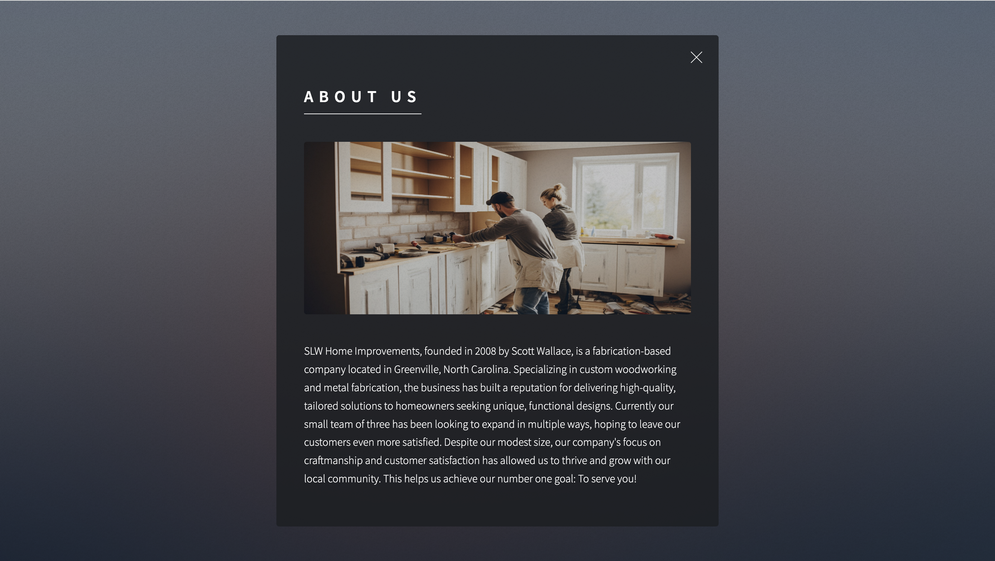
Sprint 2 PSPI
Get A Quote Page
About Us Page

Slide 12
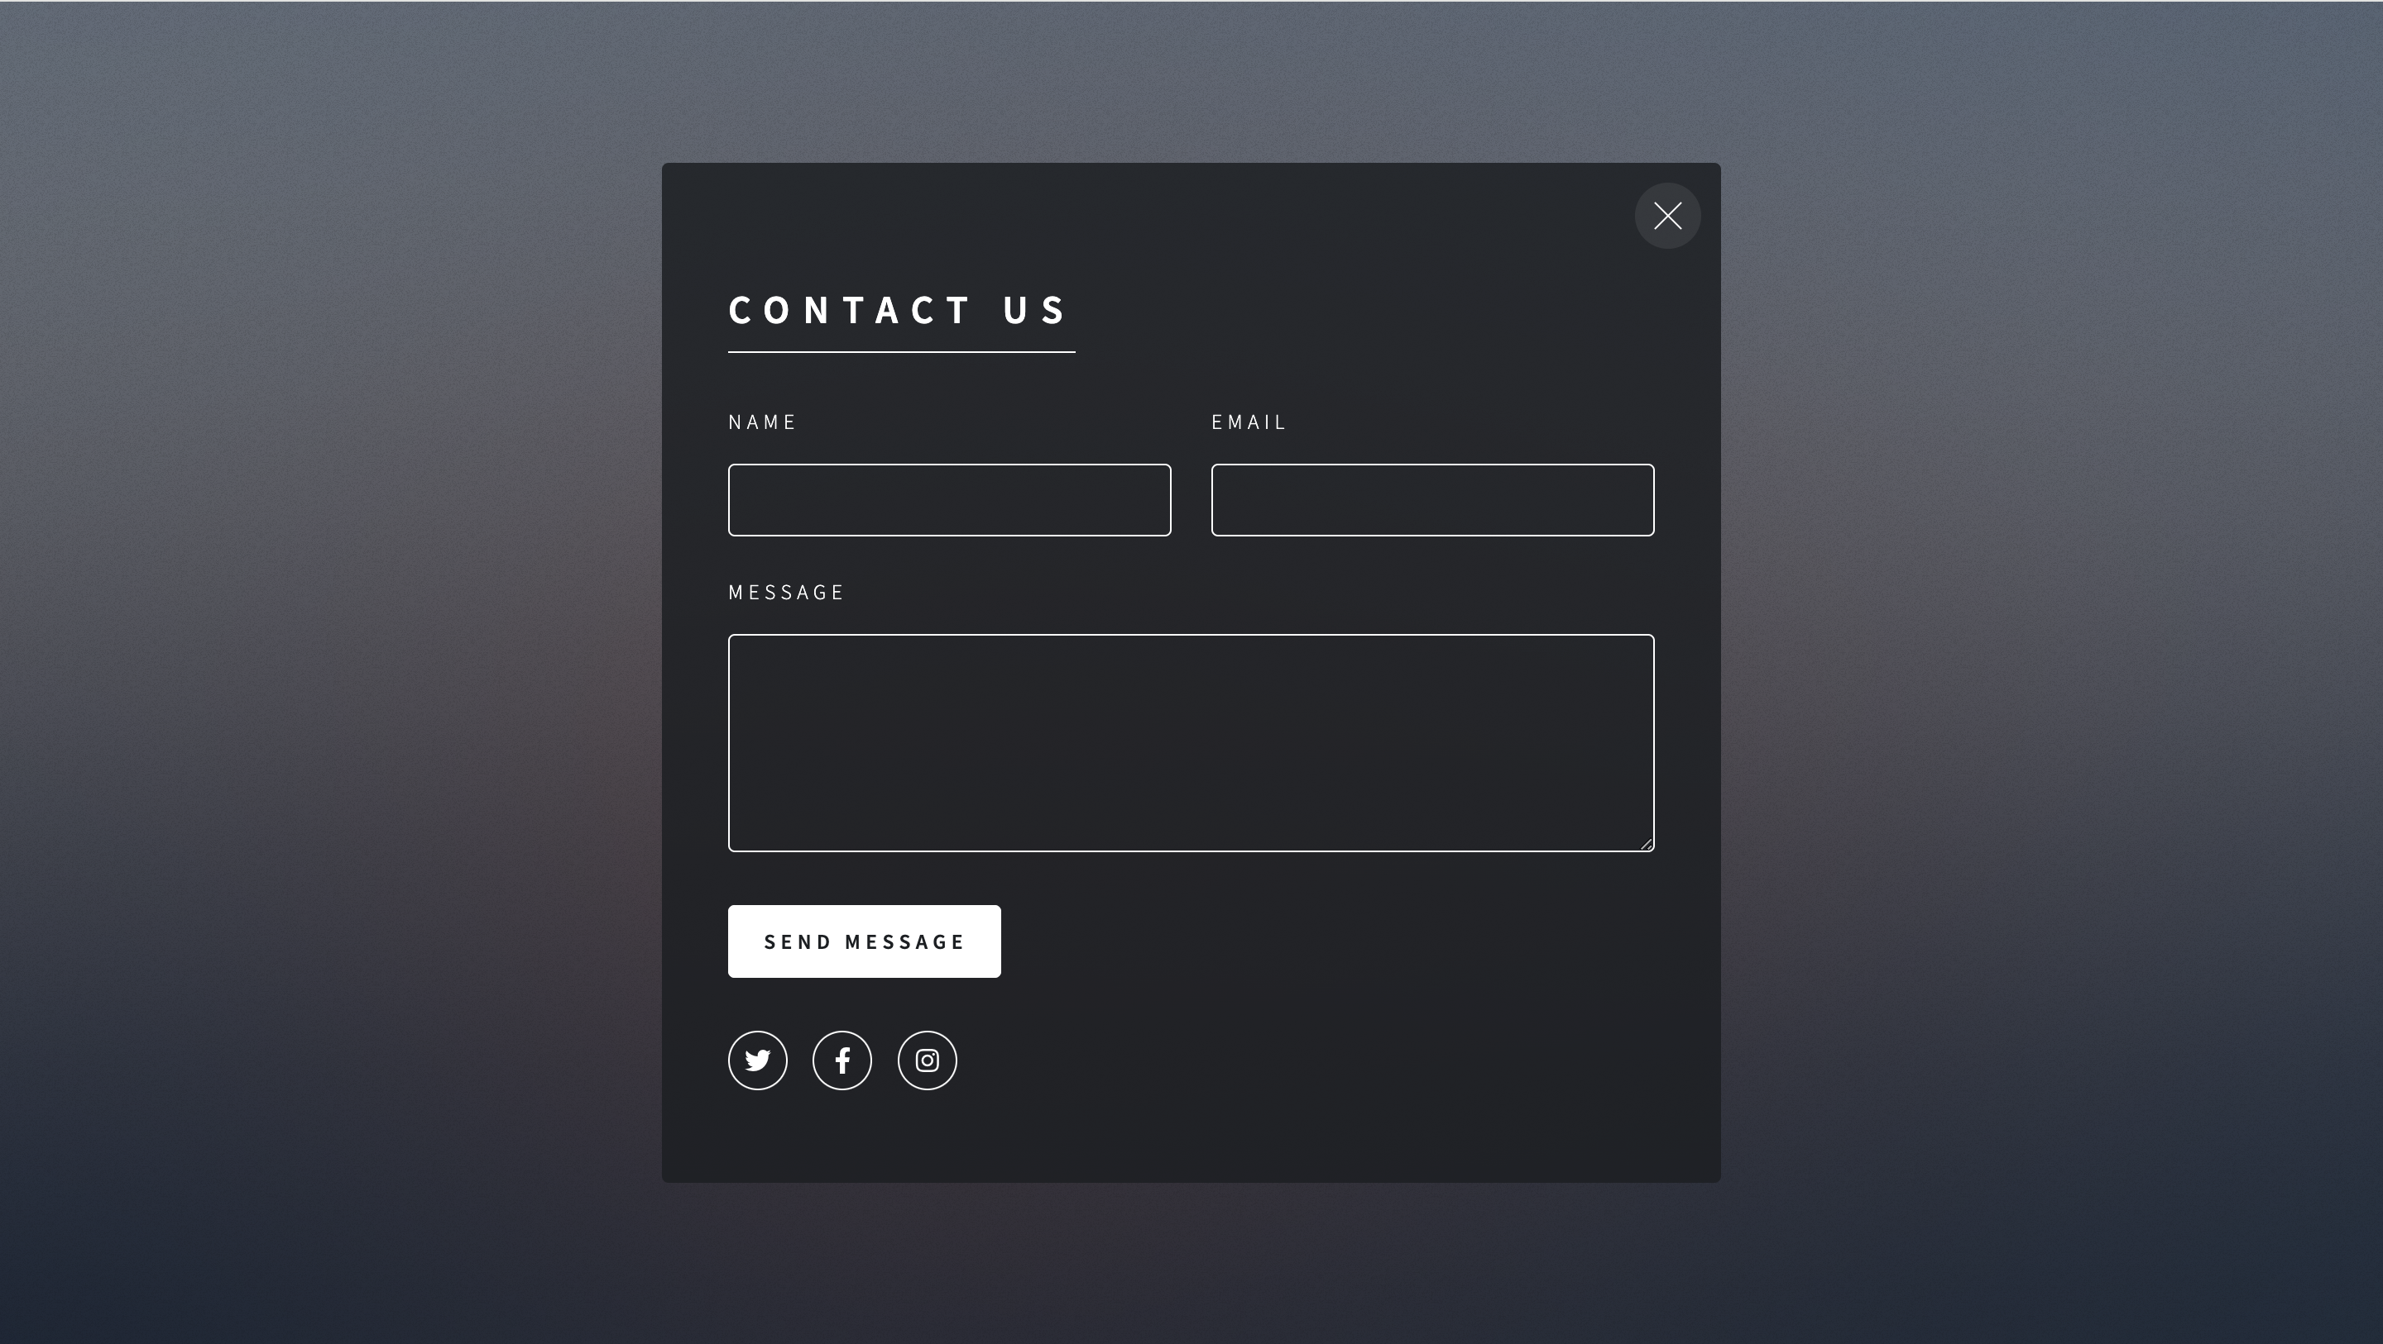
Sprint 2 PSPI
Contact Us Page

Slide 13
Questions?

